Slide 1
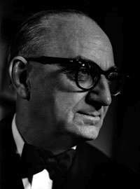
Topic 1.7 - Politics
How does a government influence a country’s culture?
What age do you think is an appropriate age for citizens to have the right to vote? Why?

Slide 2
Cultural Differences
In Columbia – Age15 to legally buy cigarettes
Canada – Age 18 or 19 to buy cigs and drink alcohol.
Kuwait/USA – Age 21
All of these countries have decided that some kind of legal control needs to be placed on the sale of tobacco products to younger persons.
Each country has a different perception of the age to which this law should apply.
Cultural differences have played a role.

Slide 3
Politics and Culture
Our culture affects the law and policies of the Government.
Politics is the process by which groups make decisions.
We need reliable, up to date information in order to make good decisions.
Data to make good decisions could include such things as:
- Population Information
- Gross Domestic Product

Slide 4
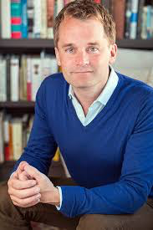
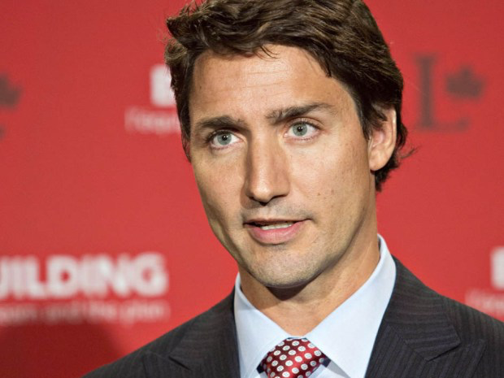

Slide 5
Parliamentary System
Our country is divided up into 338 ridings (Sittings in the house of commons).
Each riding is represented by an elected individual.
The political party which has the most elected members forms the government.
The other party(ies) which have the lesser number of seats form the opposition.

Slide 6
5 types of Government Include:
1. Majority (50% + 1 seat, party with most seats form the government).
2. Minority (<50% of seats, get support of other parties for individual notes/issues).
3. Coalition (<50% of seats, two or more parties work together and share power).

Slide 7
6. Forms or levels of Government
1. Local Government: Municipal
2. Province-wide/Provincial Government: Provincial
3. Country Wide or National Government: Federal
7. Governments are elected in this democratic system (also called a democracy) and are supposed to represent the wishes and values of those who elect the individuals to the government.

Slide 8
8. Note Sheets
8. A Constitution is a set of basic rights for all citizens of this country. This was developed to protect the minority of people in the country who are represented by the opposition parties in government.
- This ensures that government decisions cannot be made that will take away the rights of individuals.
9. Government decisions and policies affect all aspects of our culture. Governments use economic, geographic and historical data to bring about legislation that governs all aspects of our lives.

Slide 9
Who are your Representatives?
Federal – Prime Minister – Justin Trudeau
MP – St. John’s South/Mt. Pearl -
Seamus O’Reagan
Provincial – Premier – Dwight Ball
MHA – Waterford valley – Tom Osbourne
MHA – St. John’s West – Siobhan Coady
Municipal
Mayor – Danny Breen
Deputy Mayor – Sheilagh O’Leary
Deputy Mayor –Ward 5 Counsellor – Wally Collins
Know these people for your quiz!!!

Slide 10
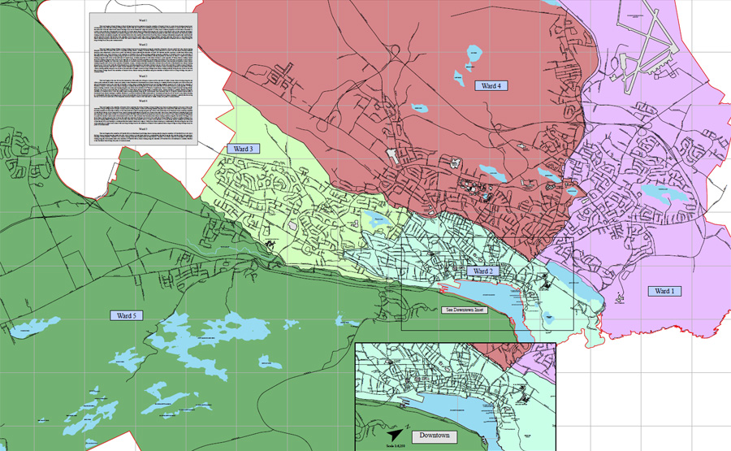

Slide 11
Why is Ward 5 so much bigger than the other wards?
It has the most farmland
The fewest people
The fewest sidewalks
What types of people/job occupations selected ward 5 as a place to live?
http://www.gregpike.ca/local-news/st-johns-election-what-ward-are-you-in/

Slide 12
Democracy
Is the rule of the majority
This how the Canadian government operates (Thankfully).
http://www.ed.gov.nl.ca/edu/k12/curriculum/documents/socialstudies/2010/NLS2205-03b(ch1_pp52-73).pdf
Pg 71

Slide 14
Hey Pam….
Various groups can lobby for their beliefs however, the government will not always rule in their favor…
Economics
History
Geography
https://www.youtube.com/watch?v=pohvl0oKxbE

Slide 15
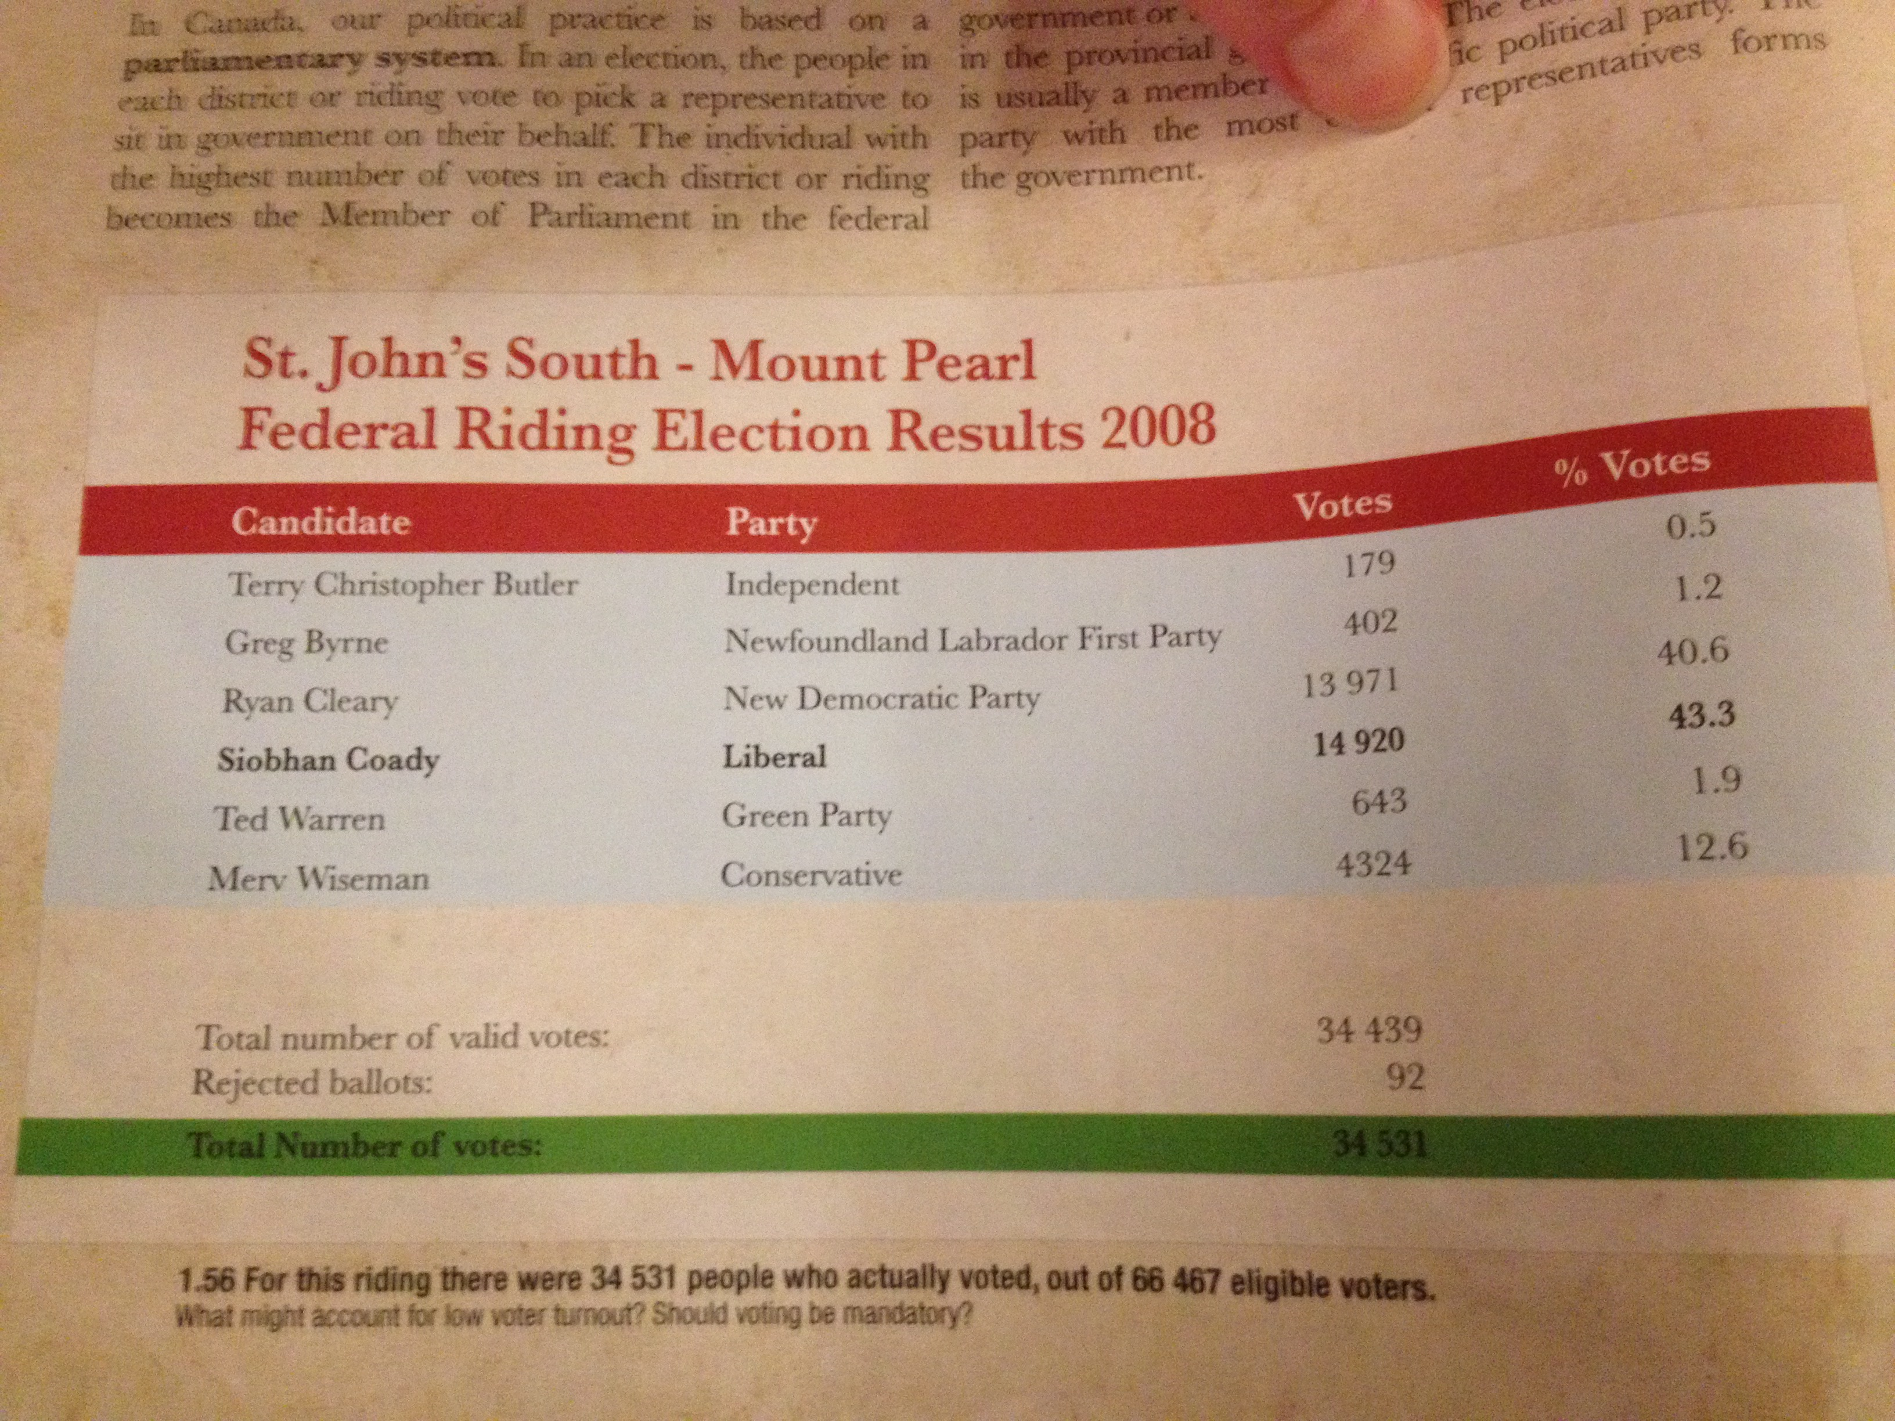
Why didn’t people vote?

Slide 16
Quality of Life Indicators
1. Health
2. Education
3. Economic Self Reliance
4. Prosperity
5. Employment
6. Economic Security
7. Sustainability

Slide 17
Assignment – Text Book Pag 73
Have a look at the maps showing the composite values/quality of life indicators and answer the questions on the sheet.

Slide 18
Topic 1.8 – Group Identity

Slide 19
To Belong….
When people share a culture (or parts of it), they often feel a sense of belonging.
This feeling can be based on shared experiences.
Having a group IDENTITY can create a sense of unity among its members.

Slide 20
How about you?
Are you a Newfoundlander?
Are you a Canadian?
Are you from the Bay/Townie?
Are you from da Bride?
Distinctive expressions of culture – Contribute to that area’s sense of identity.
Eg. Your must be from Admirals Beach because of the way you speak!!!

Slide 21
Not all….
Not all who belong to a specific group, will have the same definition of what that group’s identity is.
Example – I grew up in Newfoundland, but I’m not from there.

Slide 22
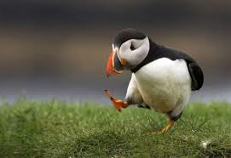
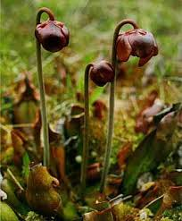
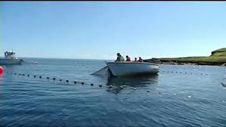
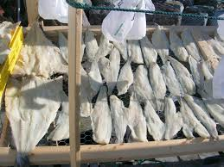
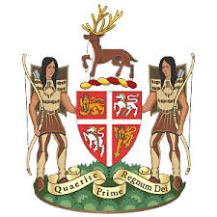
Provincial Symbols of Identity

Slide 23
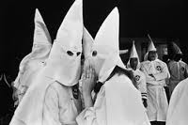

Slide 24
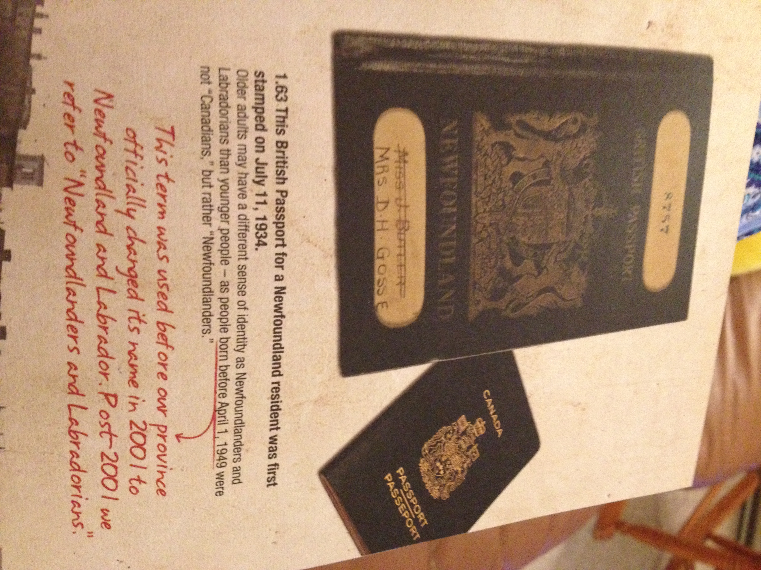

Slide 25
What about this symbol???
Lets look more into this……

