Slide 1
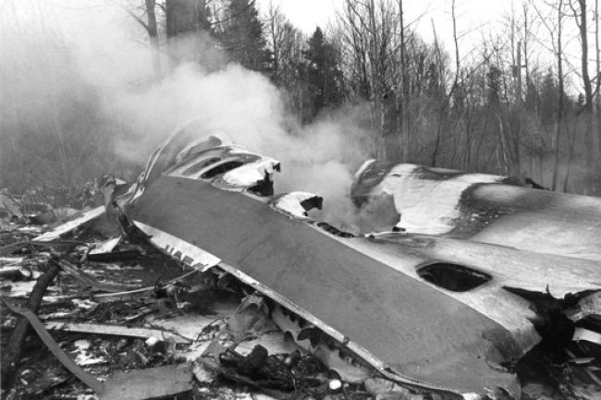
Arrow Air Disaster
Dec 12, 1985

Slide 2
Gander International Airport
In the Aviation world, Gander is well known.
Gander is an international airport and at one point, was the only international airport in Newfoundland.
It opened in 1938 and by 1941 had 4 runways making it the largest airport in the world.
It was used heavily by the Royal Canadian Airforce during wartime.
It was regarded as a prominent international pit stop by planes travelling between North America and Europe before the creation and during the early years of St. John’s International airport.

Slide 3
Gander International Airport
What do you know about Gander International Airport’s involvement in the 911 attacked on the world trade center?
38 planes were diverted to Gander Airport once North American Air Space’s were shut down.
A book was written about this experience.

Slide 4
Air Disaster
The largest aviation disaster on Canadian soil happened at Gander International Airport on December 12, 1985.
Arrow Air Flight 1285 was a McDonnell Douglas DC-8-63CF jetliner, operating as an international charter flight carrying U.S. troops from Cairo, Egypt, to their home base in Fort Campbell, Kentucky, US.
Gander, Newfoundland was a refueling stop for this flight.

Slide 5
Arrow Air Crash
On the morning of Thursday, 12 December 1985, shortly after takeoff from Gander en-route to Fort Campbell, Kentucky, US, the aircraft stalled, crashed, and burned about half a mile from the runway.
All Army and Airline personnel died in this crash.
As of 2017, it has the highest death toll of any aviation accident on Canadian soil and the second-highest of any accident involving a DC-8.

Slide 6
Trajectory of the Plane
https://www.youtube.com/watch?v=tM6jntMaOIQ
The plane took off from the airport and landed at the bottom of Gander River.

Slide 7
What exactly Happened?
One of the very few plane crashes that have happened in this world in which investigators cannot agree as to what was the cause.
Lets have a look. What do you think caused the plane crash?
https://www.youtube.com/watch?v=u3bStSrnTQ0

Slide 8
Mayday
is a Canadian documentary television program investigating air crashes, near-crashes, hijackings, bombings and other disasters.
Mayday uses re-enactments and computer-generated imagery to reconstruct for its audiences the sequence of events leading up to each disaster. In addition, aviation experts, retired pilots and crash investigators are interviewed explaining how these emergencies came about, how they were investigated and how they could have been prevented.
You can find Mayday on the Discovery Channel.
The Arrow Air Disaster was profiled on Mayday during season 11, Episode 3.
List below is the US show – Air Disaster – that is the same as the Mayday Video.
http://www.dailymotion.com/video/x2wqxvp

Slide 9
Poetry Relating to the Crash
https://www.youtube.com/watch?v=1CgeJTWmsxM

Slide 10
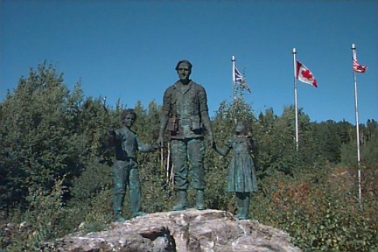
Silent Witness Memorial
Exit left off of the Trans Canada Highway in Gander travelling West.
A tranquil park dedicated to the memory of the 256 individuals who lost their lives on December 12, 1985 in the Arrow Air Crash.
This memorial park was constructed at the crash site at the foot of the Gander River.

Slide 11
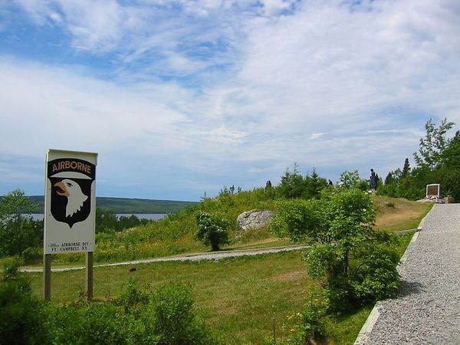
Ms. Gibbons’ Visit to Silent Witness Memorial Slide Show

