Slide 1
Elements of Photography
Pages 18-33

Slide 2
Did you know…
The word photography comes from two Greek words.
“phos” – means light
“graphis” – means paintbrush
Therefore, photography means to paint with light!

Slide 3
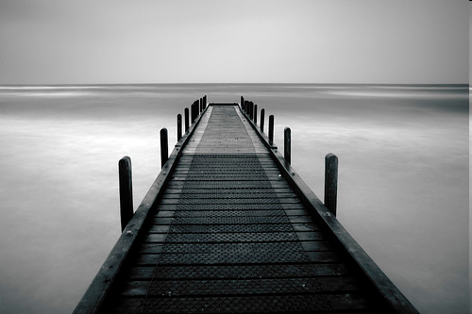
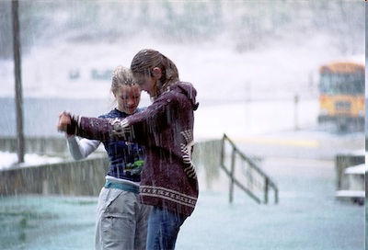
Power
Photographers who create powerful images do so with intention and purpose
Capture the subject
Engages the viewer
Notes:
Move into Exercise #1

Slide 4
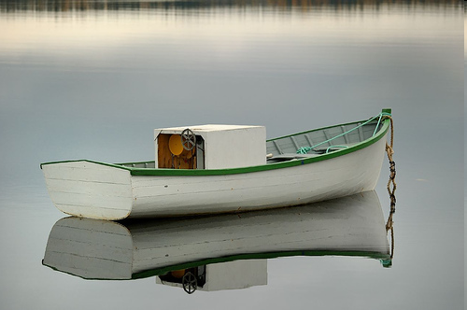
Photo 1 - Symmetrical Composition
The photo can basically fold into two equal parts
Creates a sense of balance with elements in the photo.
There is a sense of equal weight.
Take the photo: put the subject of the photo in the middle.

Slide 5
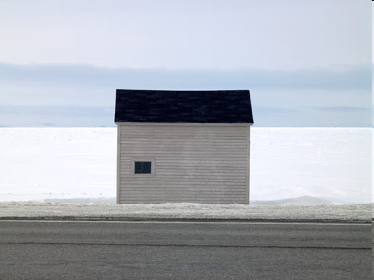
Example #1: The Pink Shed (Ned Pratt)
If you were to draw a line down (or across) the middle of this picture the content of each side would be of equal weight.

Slide 6
Photo #2: Asymmetrical Composition
Image (Subject) appears unbalanced or “off-center”
Artist arranges the subject matter until it looks right
Background distractions unwanted (subject = positive space & everything else = negative space)

Slide 7
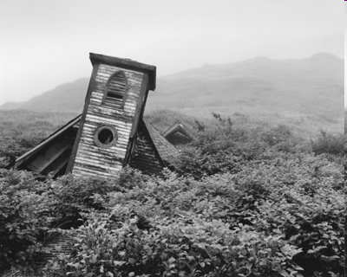
The church clearly appears to be sinking into the trees. The lack of subject matter to the right helps create the sinking feeling. In terms of balance we might describe this picture as bottom heavy. Why?
Example #2: Unsettled #6: Parson’s Harbour, South Coast

Slide 8
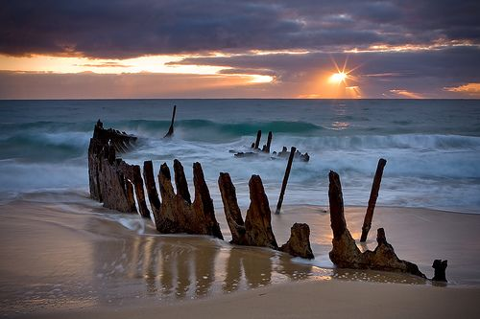
Elements of Design
PHOTO #3:
A line is a basic element of art, referring to a continuous mark, made on a surface, by a moving point.
A line is long relative to its width. It can define a space, create an outline or pattern, imply movement or texture and allude to mass or volume. Absolutely essential in creating art, the line.

Slide 9
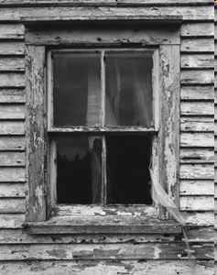
Example #3 - Unsettled #28
How many examples of line are in this picture?

Slide 10
Photo #4: Shape
A shape is an element of art. Specifically, it is an enclosed space, the boundaries of which are defined by other elements of art (i.e.: lines, colors, values, textures, etc.).
Take 1 Photo of an oject with a shape.
Geometric shapes - circles, rectangles, squares, triangles and so on - have the clear edges one achieves when using tools to create such shapes.
Organic shapes have natural, less well-defined edges (think: an amoeba, or a cloud).

Slide 11
Photo #5 - Texture
Texture, another element of art, is used to describe either the way a three-dimensional work actually feels when touched, or the visual "feel" of a two-dimensional work.
Take rocks, for example. A real, 3-D rock might feel rough or smooth, and definitely feels hard when touched or picked up. A painter, depicting a rock, would create the illusions of these qualities through use of color, line, shape, etc.

Slide 12
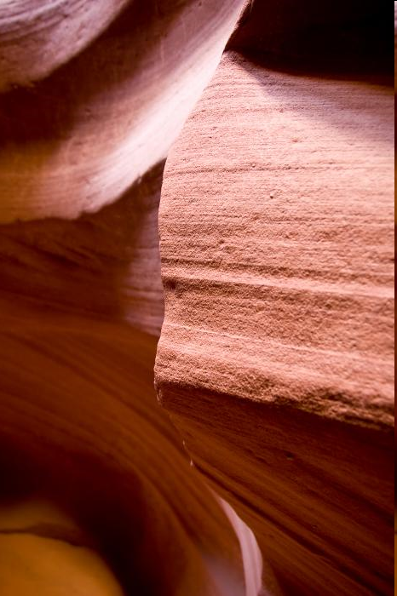
Example #5
Sandstone

Slide 13
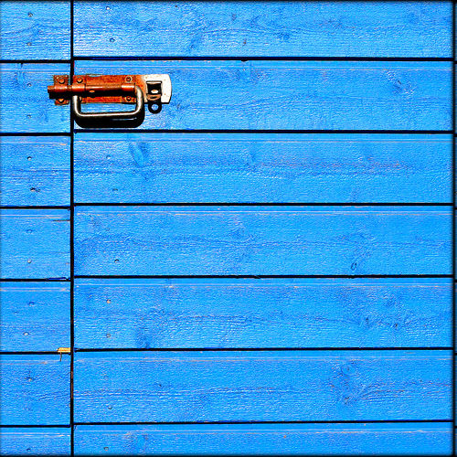
Photo #6 - Perspective
Point from which the object/subject is viewed
Birds eye
Worms eye
Establishes emphasis
Move closer, move back, move up, down
EG; Worms Eye
Only Take 1 photo of either type.

Slide 14
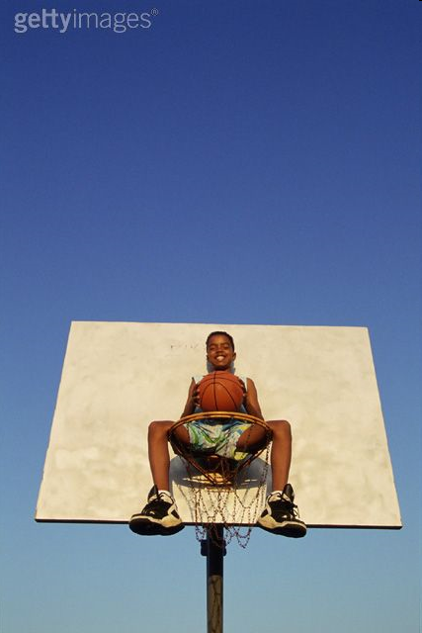
Perspective
Eg. Birds Eye

Slide 15
Photo #7 - Light
Light is a powerful tool
Direction
Strength
Time of day (warm & cold)
Lack of light also effective
Shadow etc.

Slide 16
Single light source – Can set the overall theme/mood of the photo

Slide 17
Photo #8 - Color
There are so many colors of the world.
Take a photo with many colors or with just 1 color that is vibrant and speaks to the viewer.

Slide 18
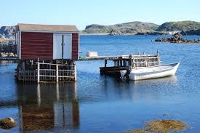
At the Light Box….
Pg. 32 and 33.
Lets examine each photo and discuss the elements of each photo. ☺

Slide 19
Here’s the book!!!
http://www.ed.gov.nl.ca/edu/k12/curriculum/documents/socialstudies/2010/NLS2205-02(photo_pp15-34).pdf

