Slide 1
My Photography Assignment
Submitted by:

Slide 2
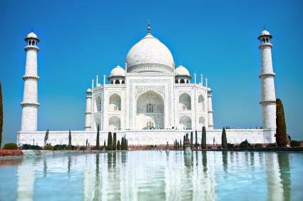
#1. Symmetrical – Tajmahal
Explanation: What makes this photo symmetrical? Look at the photography notes.

Slide 3
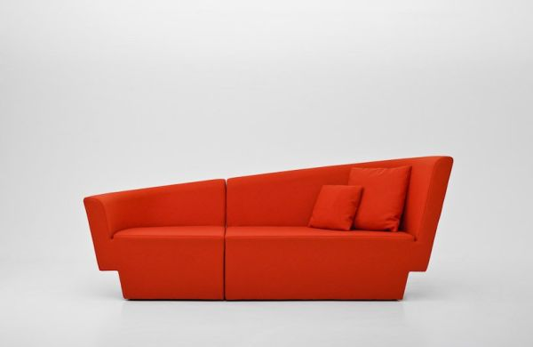
2.Assymetrical - A Couch
Explanation: What makes this photo assymetrical?

Slide 4
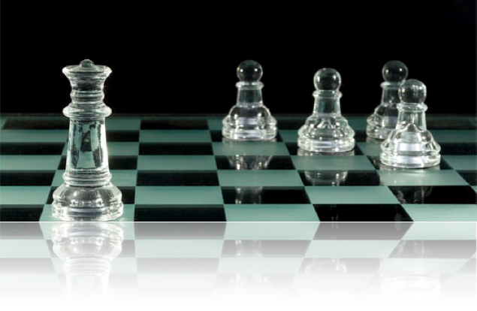
3. Line - Chess
Explanation:

Slide 5
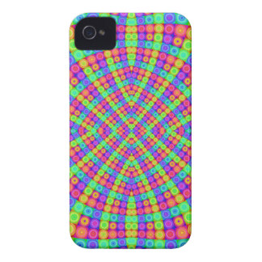
4. Shape - A Phone
Explanation:

Slide 6
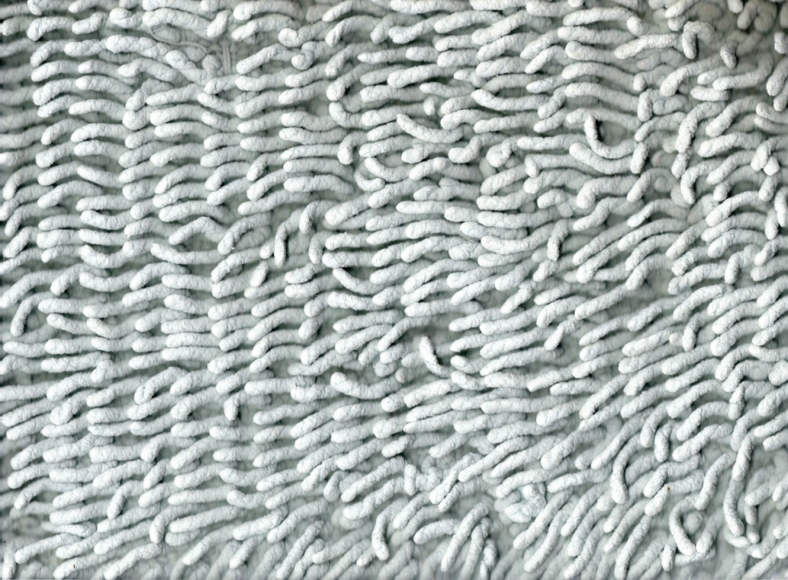
5. Texture - A Bath Towel
Explanation:

Slide 7
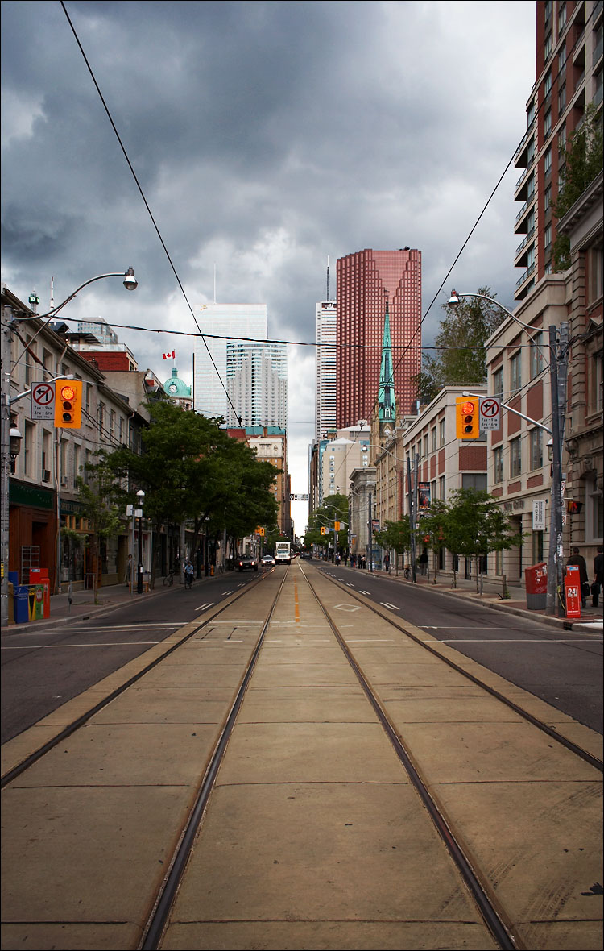
6. Perspective -
Explanation:

Slide 8
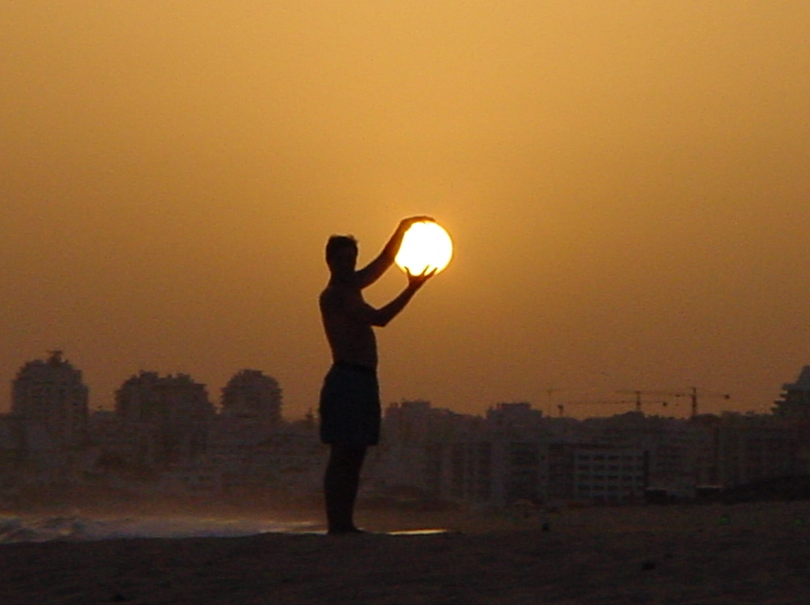
7. Light – Touching the Sun
Explanation:

Slide 9
8. Color – A painters Palate
Explanation: The painters palate shows many colors that are very vibrant on this photo.

