Slide 1
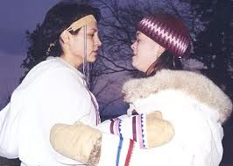
What is Culture
Topic 1.1, Pg. 36-39

Slide 2
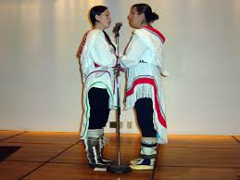
Inuit Throat Signing
This is very much a part of their culture.
https://www.youtube.com/watch?v=qnGM0BlA95I

Slide 3
What is Culture?WRITE THIS DOWN!
the way of life of a group of people.
Culture reflects what people value, including tangible (ex: jigs dinner) and intangible (ex: religious beliefs) expressions transmitted to us from the past (our heritage).

Slide 5
Where and Why?
Jiggs dinner is a traditional meal commonly prepared and eaten on Sundays in many regions around our province.
Salted Beef boiled with Cabbage, Turnip, Carrots, Potatoes ……..
Pease Pudding, Figgy Duff
Condiments: Mustard Pickles, Beats, Cranberry Sauce, Butter.
Gravy made from the drippings of the roasted meat.

Slide 6
Do we have a unique culture in NL?

Slide 7
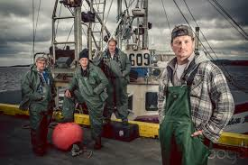
What makes our culture so unique or sets us apart?
We are known to produce hard working people.
When travelling, Newfoundlanders are happy to meet up.
We are known as a happy, welcoming culture.
Ottawa example!!!
What else?

Slide 8
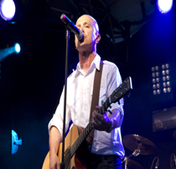
What does Damian Follett have to say?
https://www.youtube.com/watch?v=Cr3Owz0PVVc

Slide 9
Journal Entry #1 – Write ½ Page
Write a Journal Entry titled:
What does NL mean to you?
You can use these thoughts to help you write this.
What do you like about it?
What do you dislike about it?
Is this a place you would like to live for a long time (After High School). Why or why not?
What did you think of the song “No Place Like Home”? Explain.
Must be written in paragraph form, Journal Entry format.

Slide 10
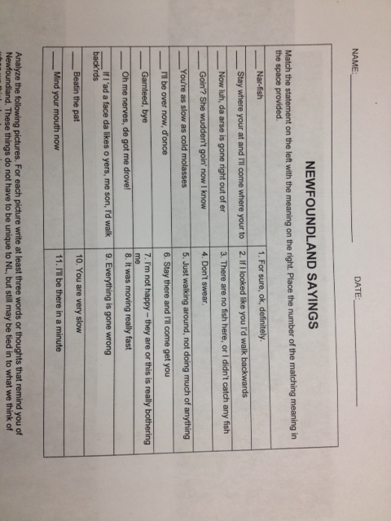

Slide 11
What are some ways that our Newfoundland Culture is preserved?
Artifacts are preserved
Stories are written down, and told, books are written.
Songs are written and sung.
Pictures are taken.
Reenactments of the past.
Museums
Courses like this one are taught.
Visual art forms (Paintings, Photos, etc)
People Carry on Traditions.

Slide 12
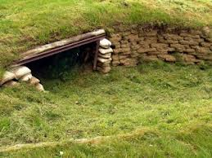

Slide 13
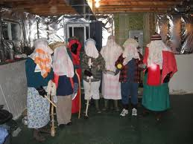

Slide 14
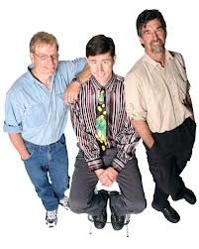

Slide 15
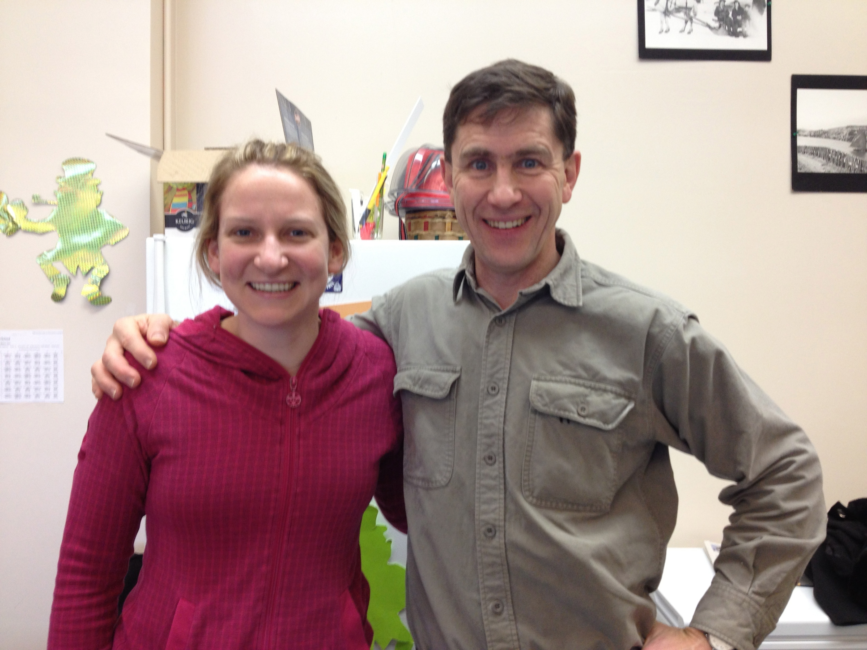

Slide 16
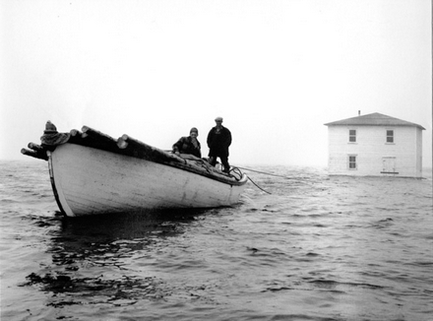
Resettlement!!
What do you know about this???

Slide 17
Common!!!
Resettlement in Newfoundland and Labrador terms was an organized approach to centralize the population into growth areas. Three attempts at resettlement were initiated by the Government between 1954 and 1975 which resulted in the abandonment of 300 communities and nearly 30,000 people moved.] Government’s attempt of resettlement has been viewed as one of the most controversial government programs of the post-Confederation Newfoundland and Labrador.

Slide 18
Argentia!!!

Slide 19
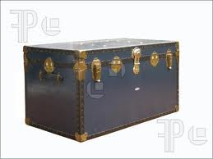
Activity 1 (Sheet 3.1a)
You have just been informed that you have to leave your home in 24 hours. You will never be able to return. Along with you family and friends, you will be travelling to a distant place where you will have to build a new home and community. You are able to take “SOME” of your belongings with you. However, all of your possessions must fit into a single Travel Trunk. What will you take?

Slide 20
Insight!!!
Each of the things that you choose to include in the travel trunk, provides insight into your culture.
Culture is made you up behaviors, values, thoughts etc.
Cultural Traits – the identifiable elements of a cultural complex (Tangible and intangible).

Slide 21
Culture Traits Pg. 36-37 (This is on your Note Sheet 1)
Cultural Traits – can be organized into
3 Components
- Artifacts – Objects we use. They provide basic necessities of life. Eg. Buildings, tools, cars, musical instruments
- Sociofacts – Ways we act around others and rules that govern our behavior. Eg. Families, governments, sports organization.
- Mentifacts – The shared ideas, values and beliefs of a culture. Eg. Religion, language

Slide 22
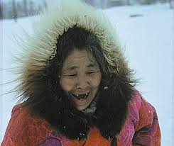
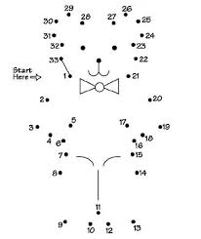
Connections
We will look at how culture traits connect.
Culture Complex – when 2 or more culture traits interact with each other.

