Slide 1
Topic 1.9
Why does Culture change?
“Hey Class, why do you think it changes?”

Slide 2
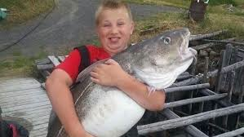
One Word!!!!
The Cod Moritorium in 1992 was a big change.
It changed the culture of NL forever!

Slide 3
Focus!!!!
This topic is basically about cultures that interact with one another.
In some cases, the interacting culture(s) totally change and/or will acquire/practice characteristics of that culture.
EG. Newfoundlanders who live/work in Alberta and return home – will wear cowboy hats when they are in Newfoundland.

Slide 4
Ms Gibbons’ Experience!!!
I’ve told you about how in 2012, I travelled to Africa and spent 3 weeks helping to educate teachers there about teaching.
During this time, during the work day, I had to follow cultural practices of the African people.
Eg. Women did not wear pants and had their shoulders covered. During the work day, I had to do the same - wear skirts and shirts that covered my shoulders. Thus, when teaching PE, I wore a skirt and sneakers!!!
I don’t think I’ll ever do that here…. But you never know!!!

Slide 5
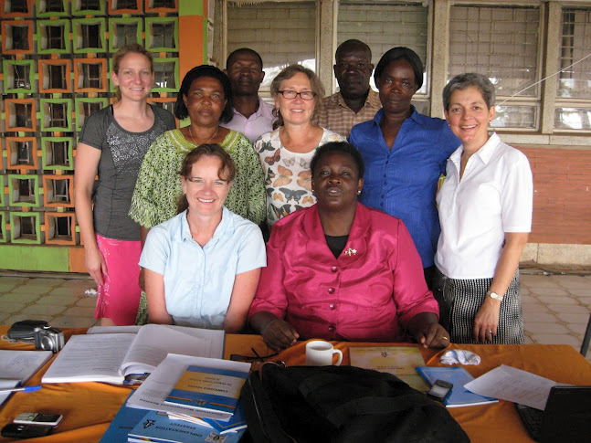

Slide 6
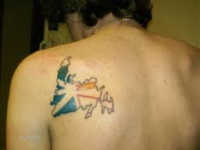
Terms
Time-Space Compression – Increases in technology cause the speed of communication to increase and improvements in transportation. - Know for the quiz – This is on your note sheet!!!

Slide 7
Example…
People can work for companies that are not based in the same place where they live.
This is because of technology.
Eg. People can live in St. John’s and can work for companies based in Singapore.
There exists potential for cultural interaction.
As a result, cultures can change.

Slide 8
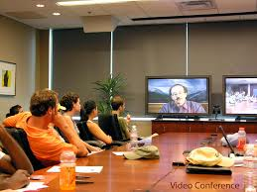

Slide 9
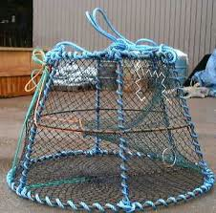
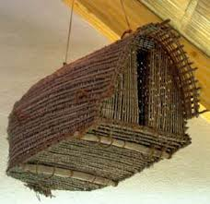
3 Ways to Describe How Culture Changes
1. Innovations – refers to the emergence of new ideas. Objects or techniques, Eg. Cod Traps have improved over the years!
New Trap
Old Trap

Slide 10
2. Relocation Diffusion – When an idea, object or technique is introduced to a culture from an external source, Eg. Pizza – Its here to stay!!!!

Slide 11
3. Large-Scale Interaction – When two cultures interact, each culture will be altered.
a. Acculturation: When one culture dominates another culture. Eg. Native being dominated by “White” culture.
b. Transculturation: Two cultures interact and a relatively equal change in both groups occurs.
Eg. 2 cultures interacting.

Slide 12
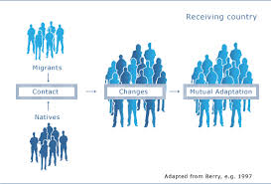
Acculturation

Slide 13
Journal Entry #2
Check out page 84-85 in your book.
Think about 2 things that you cannot imagine living without. (you may use the items on page 84-85 as ideas).
Write a paragraph about each item.
Include in your paragraph:
- What was life like before this item.
- What is life like now? (Ie. Why could you not live without this item.
Total response (Including 2 paragraphs) should be ½ page at least on looseleaf!!! (These are located on the shelf next to the student binders).

Slide 14
