Slide 1
Topic 1.8 – Group Identity Pg. 74 - 79

Slide 2
To Belong….
When people share a culture (or parts of it), they often feel a sense of belonging.
This feeling can be based on shared experiences.
Having a group IDENTITY can create a sense of unity among its members.

Slide 3
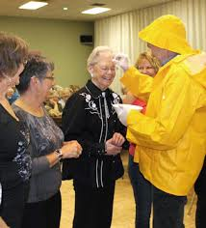
How about you?
Are you a Newfoundlander?
Are you a Canadian?
Are you from the Bay/Townie?
Are you from da Bride?
Distinctive expressions of culture – Contribute to that area’s sense of identity.
Eg. Your must be from Admirals Beach because of the way you speak!!!

Slide 4
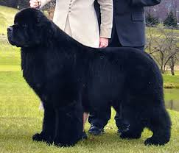
Not all….
Not all who belong to a specific group, will have the same definition of what that group’s identity is.
Example – I grew up in Newfoundland, but I’m not from there.

Slide 5
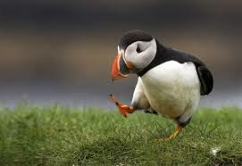
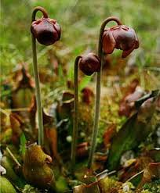
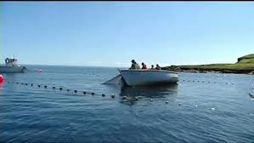
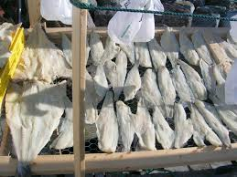
Provincial Symbols of Identity

Slide 6
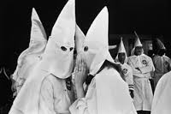

Slide 7
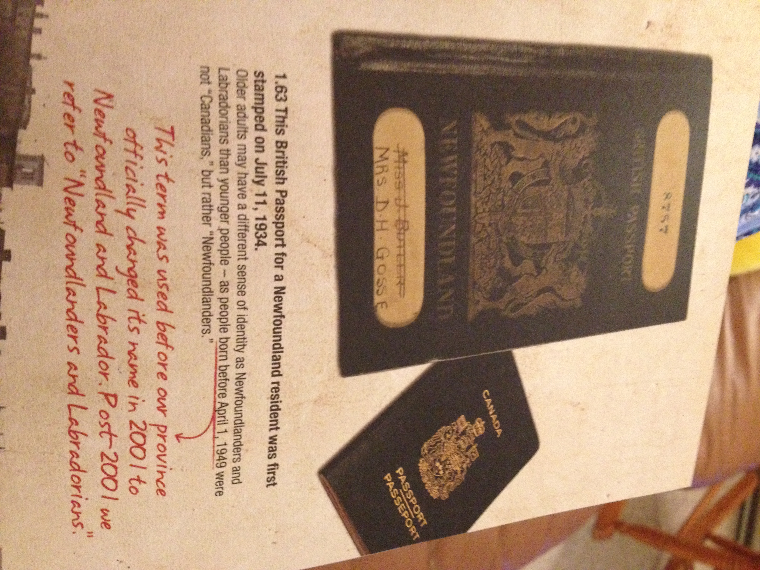

Slide 8
AUGUST 2014 – People wanted to celebrate the
Anniversary of the flag by flying it next to the NL Flag at
Various entry points in Labrador. They were denied!!!
- Have a quick look at this article.
http://www.thetelegram.com/Opinion/Columnists/2014-08-23/article-3843923/Let-the-Labrador-flag-fly/1

Slide 9
What about this symbol???
Lets look more into this……
- You will be doing this assignment once topic 1.9 is finished.

